Slide 1

AuTURBO 2018 – training Week 5
Embeded Tensorflow

Slide 2
Tensorflow install(CPU version)
~$ sudo apt-get install python-pip
~$ sudo pip install --upgrade pip
~$ sudo pip install tensorflow==1.4.0

Slide 3
Tensorflow install(1.4.0 GPU version)
1. cuda 8.0 Download
2. cudnn 6.0 Download
~$ cd ~/Download
~$ chmod +x cuda_8.0.44_linux.run
~$ ./cuda_8.0.44_linux.run
accept → enter
n → enter
y → enter → enter →y → password → enter → y → enter → n → enter
~$ tar xvfz cudnn-8.0-linux-x64-v6.0.tgz
~$ sudo mv cuda/include/* /usr/local/cuda/include
~$ sudo mv cuda/lib64/* /usr/local/cuda/lib64
~$ echo ‘export LD_LIBRARY_PATH=${LD_LIBRARY_PATH}:/usr/local/cuda/lib64’ >> ~/.bashrc
~$ echo ‘export CUDA_HOME=/usr/local/cuda’ >> ~/.bashrc
~$ sudo apt-get install python-pip
~$ sudo pip install --upgrade pip
~$ sudo pip install tensorflow-GPU==1.4.0

Slide 4
Tensorflow install(1.7.0 GPU version)
1. cuda 9.0 Download
2. cudnn 7.1.2 Download
~$ cd ~/Download
~$ chmod +x cuda_9.0.176_384_linux.run
~$ ./cuda_9.0.176_384_linux.run
accept → enter
n → enter
y → enter → enter →y → password → enter → y → enter → n → enter
~$ tar xvfz cudnn-9.0-linux-x64-v7.1.tgz
~$ sudo mv cuda/include/* /usr/local/cuda/include
~$ sudo mv cuda/lib64/* /usr/local/cuda/lib64
~$ echo ‘export LD_LIBRARY_PATH=${LD_LIBRARY_PATH}:/usr/local/cuda/lib64’ >> ~/.bashrc
~$ echo ‘export CUDA_HOME=/usr/local/cuda’ >> ~/.bashrc
~$ sudo apt-get install python3-pip
~$ sudo pip3 install --upgrade setuptools pip
~$ sudo pip3 install tensorflow-GPU==1.7.0

Slide 5
Tensorflow
tensor = 데이터를 표현
flow = 연산은 graph로 표현

Slide 6
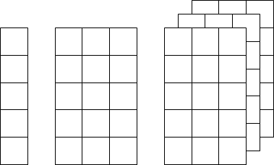
Tensorflow
tensor = ?
flow = ?

Slide 7
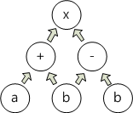
Tensorflow
tensor = ?
flow = ?

Slide 8
tensorflow 코드작성
import tensorflow as tf
hello = tf.constant(“Hello world”)
sess = tf.Session()
print sess.run(hello)

Slide 9
변수
constant : 연산가능
const1 = tf.constant([[3., 3.][4., 4.], dtype=tf.float32)
product = tf.matmul(const1, const1)
variable : 초기화 필요
var1 = tf.Variable([[3., 3.][4., 4.], dtype=tf.float32)
product = var1 * var1
init = tf.global_variables_initializer()
sess.run(init)
placeholder : 다른 변수를 그래프로 매핑(feed_dict)
mat1 = [[3., 3.][4., 4.]]
ph1 = tf.placeholder(dtype=tf.float32)
product = ph1 * ph1
feed_dict={ph1: mat1}
sess.run(product, feed_dict=feed_dict)

Slide 10
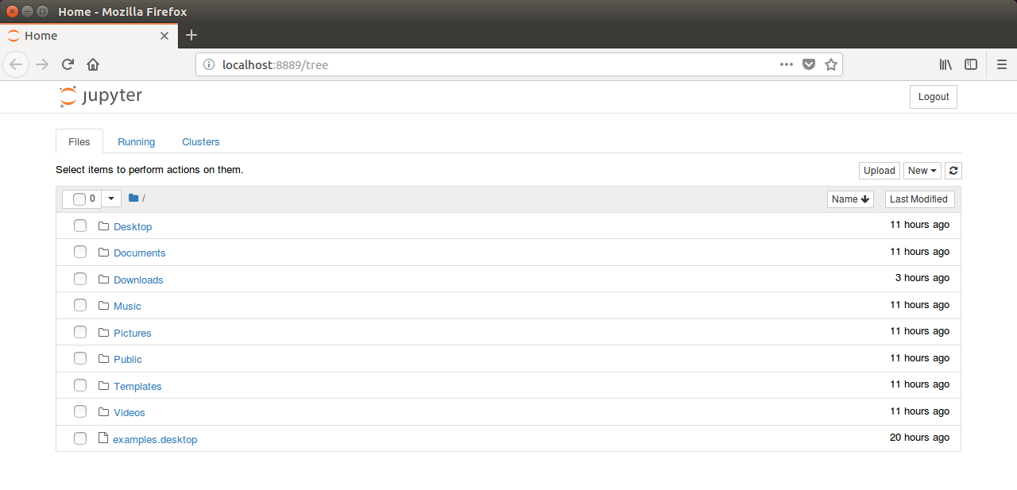
MNIST
- sudo pip install jupyter
- sudo pip install matplotlib
~$ jupyter notebook

Slide 11

MNIST
주소인식을 위해 만들어진 데이터 베이스
28×28 크기의 0~9사이의 숫자 이미지, 레이블
55,000개의 학습 데이터
10,000개의 테스트 데이터
5,000개의 검증 데이터

Slide 12
MNIST(NLP)
선언
import tensorflow as tf
import matplotlib.pyplot as plt
Dataset 불러오기
from tensorflow.examples.tutorials.mnist import input_data
mnist = input_data.read_data_sets("MNIST_data/", one_hot=True)
- 데이터 확인하기
img = mnist.train.images[0].reshape(28,28)
plt.imshow(img, cmap=‘gray’)

Slide 13
MNIST(NLP)
- 러닝관련 기본설정
learning_rate = 0.001
training_epochs = 15
batch_size = 100
X = tf.placeholder(tf.float32, [None, 784])
Y = tf.placeholder(tf.float32, [None, 10])
- 웨이트및 바이스 저장 변수
W = tf.Variable(tf.random_normal([784, 10]))
b = tf.Variable(tf.random_normal([10]))
- 최적의 코스트 계산
hypothesis = tf.matmul(X, W) + b cost = tf.reduce_mean(tf.nn.softmax_cross_entropy_with_logits(
logits=hypothesis, labels=Y))
optimizer = tf.train.AdamOptimizer(learning_rate=learning_rate).minimize(cost)

Slide 14
MNIST(NLP)
- 초기화
sess = tf.Session()
sess.run(tf.global_variables_initializer())
- 학습
for epoch in range(training_epochs):
avg_cost = 0
total_batch = int(mnist.train.num_examples / batch_size)
for i in range(total_batch):
batch_xs, batch_ys = mnist.train.next_batch(batch_size)
feed_dict = {X: batch_xs, Y: batch_ys}
c, _ = sess.run([cost, optimizer], feed_dict=feed_dict)
avg_cost += c / total_batch
print('Epoch:', '%04d' % (epoch + 1), 'cost =', '{:.9f}'.format(avg_cost))
print('Learning Finished!')

Slide 15
MNIST(NLP)
- 테스트이미지를 이용한 최종 Accuracy
correct_prediction = tf.equal(tf.argmax(hypothesis, 1), tf.argmax(Y, 1))
accuracy = tf.reduce_mean(tf.cast(correct_prediction, tf.float32))
print('Accuracy:', sess.run(accuracy, feed_dict={ X: mnist.test.images,
Y: mnist.test.labels}))

Slide 16
MNIST(CNN)
선언
import tensorflow as tf
import matplotlib.pyplot as plt
import random
Dataset 불러오기
tf.set_random_seed(777)
from tensorflow.examples.tutorials.mnist import input_data
mnist = input_data.read_data_sets("MNIST_data/", one_hot=True)
- 데이터 확인하기
img = mnist.train.images[0].reshape(28,28)
plt.imshow(img, cmap=‘gray’)

Slide 17
MNIST(CNN)
- 상수 정의
learning_rate = 0.001
training_epochs = 1000
batch_size = 100
- 데이터 매핑
X = tf.placeholder(tf.float32, [None, 784])
X_img = tf.reshape(X, [-1, 28, 28, 1]) # img 28x28x1 (black/white)
Y = tf.placeholder(tf.float32, [None, 10])
- weight 변수 초기화
W1 = tf.Variable(tf.random_normal([3, 3, 1, 32], stddev=0.01))
- 입력 Convolution
# Conv -> (?, 28, 28, 32), # Pool -> (?, 14, 14, 32)
L1 = tf.nn.conv2d(X_img, W1, strides=[1, 1, 1, 1], padding='SAME')
L1 = tf.nn.relu(L1)
L1 = tf.nn.max_pool(L1, ksize=[1, 2, 2, 1], strides=[1, 2, 2, 1], padding='SAME')

Slide 18
MNIST(CNN)
- Weight 초기화
W2 = tf.Variable(tf.random_normal([3, 3, 32, 64], stddev=0.01))
- hidden convolution
- Conv ->(?, 14, 14, 64), Pool ->(?, 7, 7, 64)
L2 = tf.nn.conv2d(L1, W2, strides=[1, 1, 1, 1], padding='SAME')
L2 = tf.nn.relu(L2)
L2 = tf.nn.max_pool(L2, ksize=[1, 2, 2, 1], strides=[1, 2, 2, 1], padding='SAME')
L2_flat = tf.reshape(L2, [-1, 7 * 7 * 64])
- Final FC 7x7x64 inputs -> 10 outputs
W3 = tf.get_variable("W3", shape=[7 * 7 * 64, 10], initializer=tf.contrib.layers.xavier_initializer())
b = tf.Variable(tf.random_normal([10]))
logits = tf.matmul(L2_flat, W3) + b
- define cost/loss & optimizer
cost = tf.reduce_mean(tf.nn.softmax_cross_entropy_with_logits(logits=logits, labels=Y))
optimizer = tf.train.AdamOptimizer(learning_rate=learning_rate).minimize(cost)

Slide 19
MNIST(CNN)
- 초기화
sess = tf.Session()
sess.run(tf.global_variables_initializer())
- 학습
print('Learning started.')
for epoch in range(training_epochs):
avg_cost = 0
total_batch = int(mnist.train.num_examples / batch_size)
for i in range(total_batch):
batch_xs, batch_ys = mnist.train.next_batch(batch_size)
feed_dict = {X: batch_xs, Y: batch_ys}
c, _ = sess.run([cost, optimizer], feed_dict=feed_dict)
avg_cost += c / total_batch
print('Epoch:', '%04d' % (epoch + 1), 'cost =', '{:.9f}'.format(avg_cost))
print('Learning Finished!')
save_path = saver.save(sess, "model/model.ckpt")

Slide 20
MNIST(CNN)
- 테스트이미지를 이용한 최종 Accuracy
correct_prediction = tf.equal(tf.argmax(logits, 1), tf.argmax(Y, 1))
accuracy = tf.reduce_mean(tf.cast(correct_prediction, tf.float32))
print('Accuracy:', sess.run(accuracy, feed_dict={X: mnist.test.images,
Y: mnist.test.labels}))

Slide 21
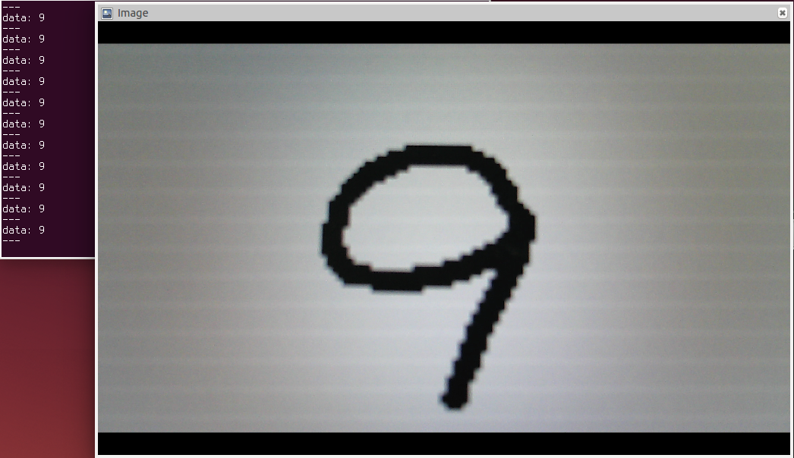
MNIST(ROS 연동)
- 선언
import rospy
from sensor_msgs.msg import Image
from std_msgs.msg import Int16
from cv_bridge import CvBridge
import cv2
import numpy as np
import tensorflow as tf

Slide 22
MNIST(ROS 연동)
- 함수선언
def weight_variable(shape):
initial = tf.truncated_normal(shape, stddev=0.1)
return tf.Variable(initial)
def bias_variable(shape):
initial = tf.constant(0.1, shape=shape)
return tf.Variable(initial)
def conv2d(x, W):
return tf.nn.conv2d(x, W, strides=[1, 1, 1, 1], padding='SAME')
def max_pool_2x2(x):
return tf.nn.max_pool(x, ksize=[1, 2, 2, 1], strides=[1, 2, 2, 1], padding='SAME')

Slide 23
MNIST(ROS 연동)
- CNN 정의
def makeCNN(x,keep_prob):
W_conv1 = weight_variable([5, 5, 1, 32])
b_conv1 = bias_variable([32])
h_conv1 = tf.nn.relu(conv2d(x, W_conv1) + b_conv1)
h_pool1 = max_pool_2x2(h_conv1)
W_conv2 = weight_variable([3, 3, 32, 64])
b_conv2 = bias_variable([64])
h_conv2 = tf.nn.relu(conv2d(h_pool1, W_conv2) + b_conv2)
h_pool2 = max_pool_2x2(h_conv2)
W_fc1 = weight_variable([7 * 7 * 64, 1024])
b_fc1 = bias_variable([1024])
h_pool2_flat = tf.reshape(h_pool2, [-1, 7 * 7 * 64])
h_fc1 = tf.nn.relu(tf.matmul(h_pool2_flat, W_fc1) + b_fc1)
h_fc1_drop = tf.nn.dropout(h_fc1, keep_prob)
W_fc2 = weight_variable([1024, 10])
b_fc2 = bias_variable([10])
y_conv = tf.nn.softmax(tf.matmul(h_fc1_drop, W_fc2) + b_fc2)
return y_conv

Slide 24
MNIST(ROS 연동)
- 클래스 선언
class RosTensorFlow():
def __init__(self):
self._cv_bridge = CvBridge()
self.x = tf.placeholder(tf.float32, [None,28,28,1], name="x")
self.keep_prob = tf.placeholder("float")
self.y_conv = makeCNN(self.x,self.keep_prob)
self._saver = tf.train.Saver()
self._session = tf.InteractiveSession()
init_op = tf.global_variables_initializer()
self._session.run(init_op)
self._saver.restore(self._session, "model/model.ckpt")
self._sub = rospy.Subscriber('image', Image, self.callback, queue_size=1)
self._pub = rospy.Publisher('result', Int16, queue_size=1)

Slide 25
MNIST(ROS 연동)
- 영상처리
def callback(self, image_msg):
cv_image = self._cv_bridge.imgmsg_to_cv2(image_msg, "bgr8")
cv_image_gray = cv2.cvtColor(cv_image, cv2.COLOR_RGB2GRAY)
ret,cv_image_binary = cv2.threshold(cv_image_gray,128,255, cv2.THRESH_BINARY_INV)
cv_image_28 = cv2.resize(cv_image_binary,(28,28))
np_image = np.reshape(cv_image_28,(1,28,28,1))
predict_num = self._session.run(self.y_conv, feed_dict={self.x:np_image,self.keep_prob:1.0})
answer = np.argmax(predict_num,1)
rospy.loginfo('%d' % answer)
self._pub.publish(answer)
def main(self):
rospy.spin()
if __name__ == '__main__':
rospy.init_node('rostensorflow')
tensor = RosTensorFlow()
tensor.main()

Slide 26
MNIST(ROS연동)
-실행
roscore
rosrun usb_cam usb_cam_node
rqt_image_view
rosrun mnist_recognition classify.py

